Slide 1
Data Analysis Challenge IPL DATASET
Member:
Sri Dharshini S

Slide 2
ABOUT THE DATASET
Dataset link : https://www.kaggle.com/datasets/patrickb1912/ipl-complete-dataset-20082020/data
This dataset, curated by Patrick Bhardwaj on Kaggle, provides comprehensive data from 13 IPL seasons (2008–2020). It includes detailed records of all matches and individual ball-by-ball deliveries played during this period.
Dataset Components:
1. matches.csv
High-level summary of each IPL match
Includes: match date, teams, toss details, venue, winner, result, player of the match, and umpires
2. deliveries.csv
Ball-by-ball data for every delivery in each match
Includes: over/ball number, batter, bowler, runs scored, dismissals, extras, and fielders

Slide 3
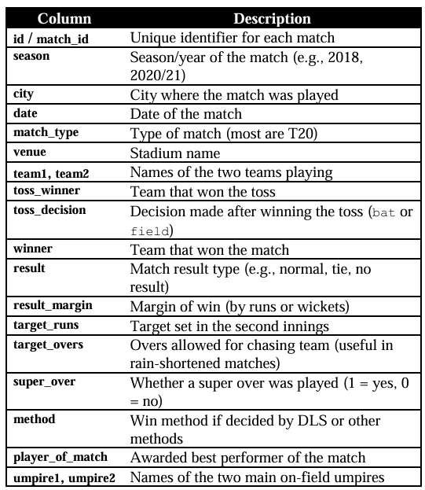
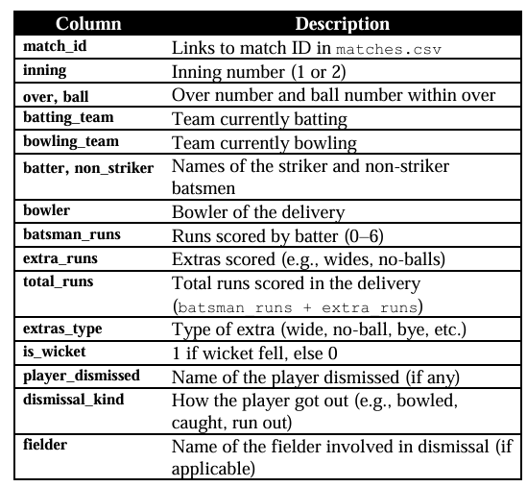
UNDERSTANDING THE DATASET
To start the data analysis first we should understand the data. Let’s review the dataset’s columns and their meanings
matches.csv – Match-level Summary
This file contains one row per match
deliveries.csv – Ball-by-Ball Details
This file contains one row per delivery (ball)

Slide 4
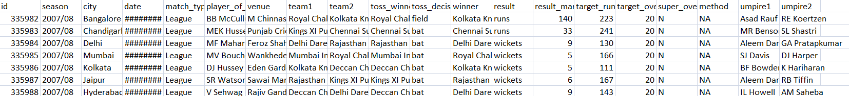

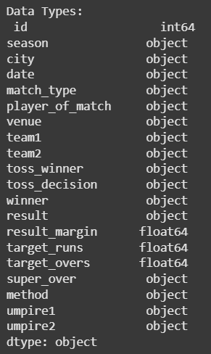
In matches.csv :

Slide 5
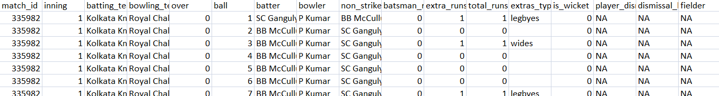

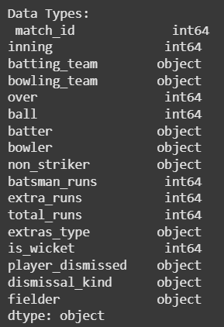
In deliveries.csv :

Slide 6
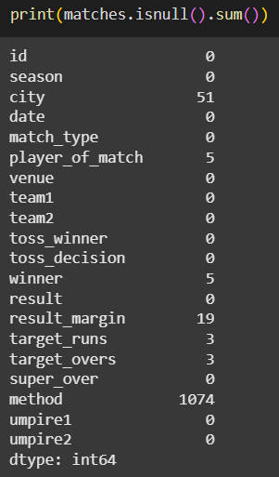
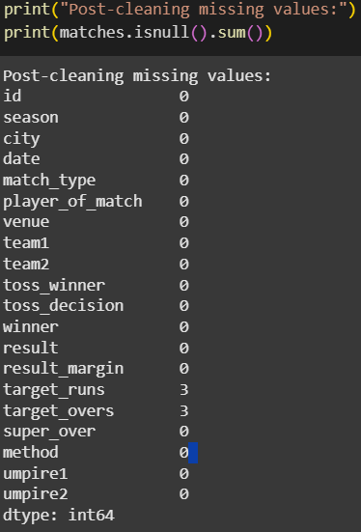
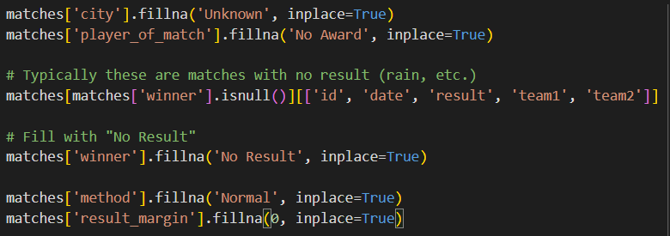
EXPLORATORY DATA ANALYSIS
For matches.csv
Data Cleaning :
First step of data cleaning is to check for null and duplicate values and then handle them
Null values were found and treated and there are no duplicate values
Code to treat the null values by replacing the null values with suitable values
Before Cleaning
After Cleaning

Slide 7
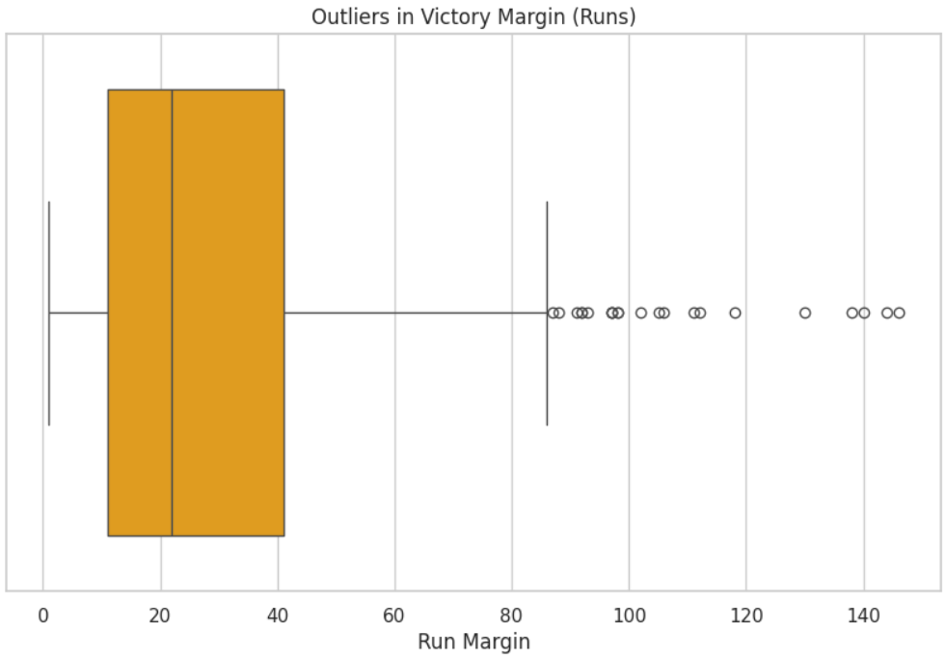
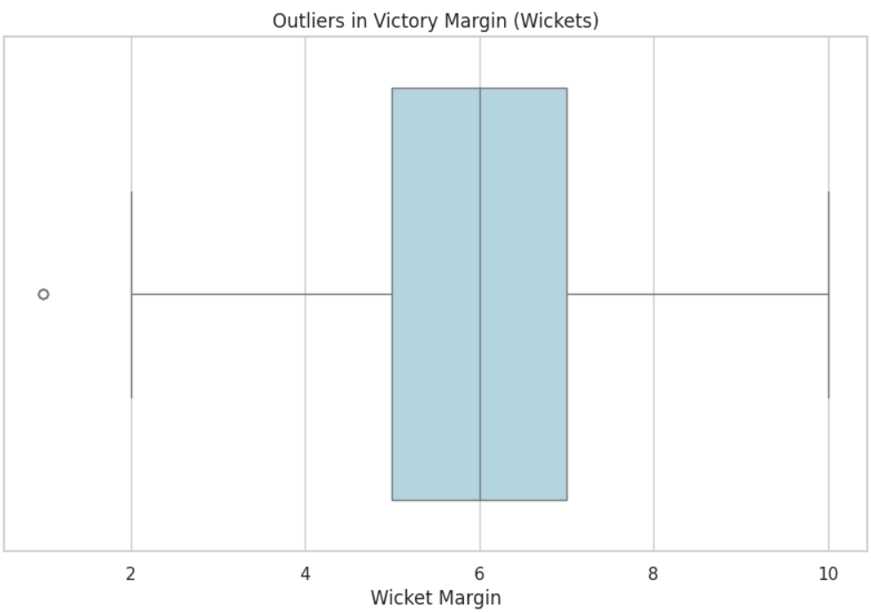
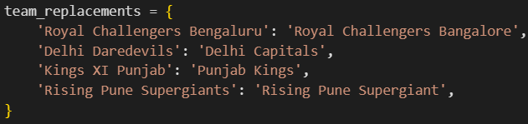
Next step is to check for outliers and treat them
And convert 'date' column to datetime
Outliers sometimes help in data analysis to analyze the extreme values so here the outliers in wicket margin and run margin are kept as such
Check for unique values
The dataset contains team name variations and old/renamed franchises. For accurate analysis we should unify team names.

Slide 8
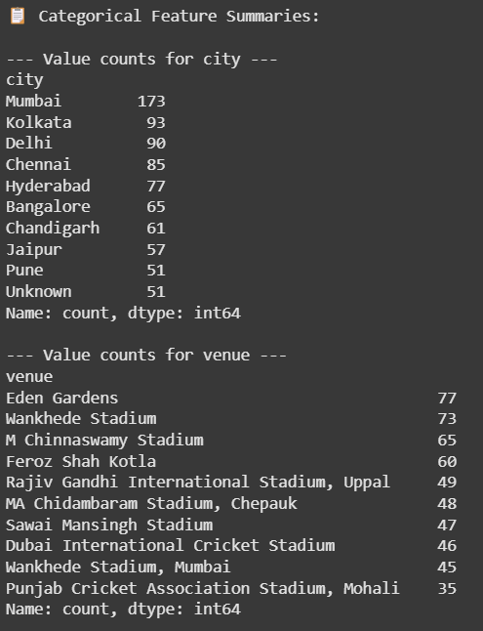
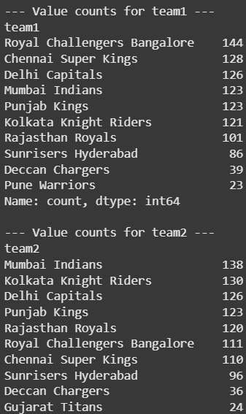
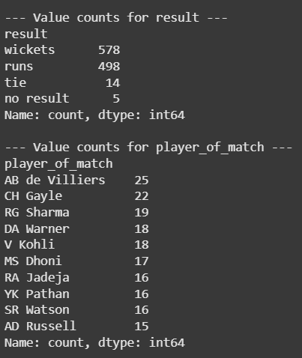
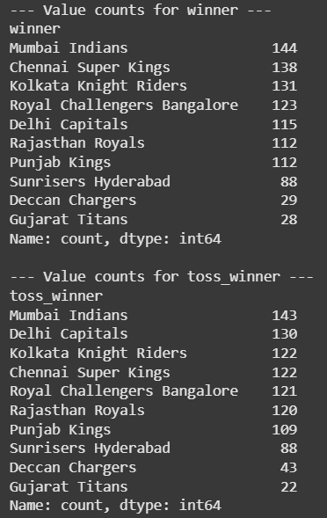
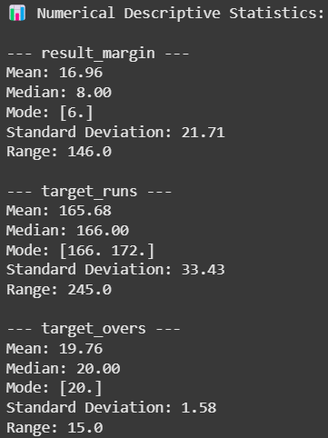
Descriptive Statistics:
- Calculate mean, median, mode etc., and summarize categorical features with value counts.
Categorical values count and their summaries
Numerical Statistics

Slide 9
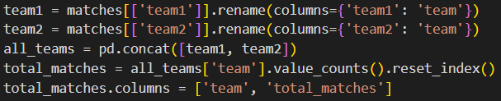

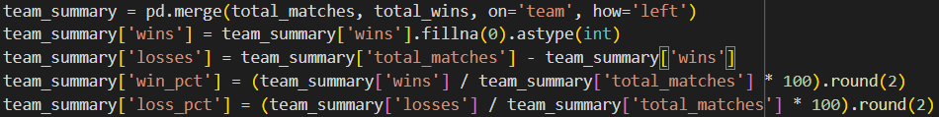
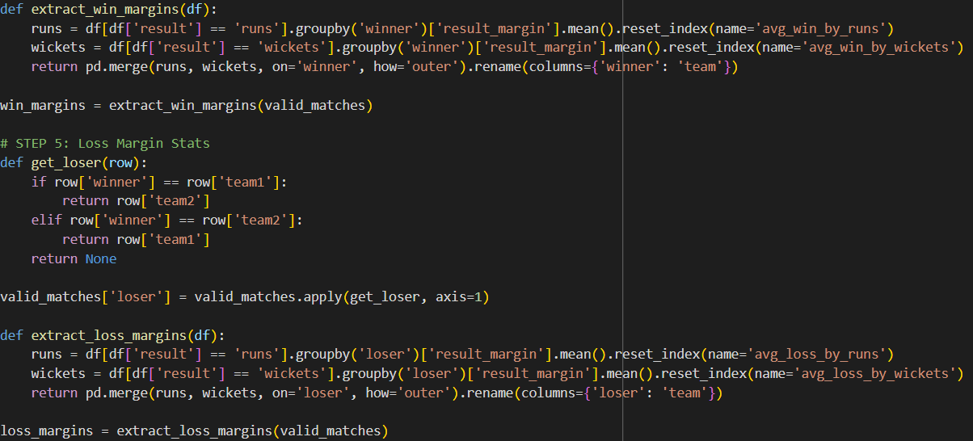
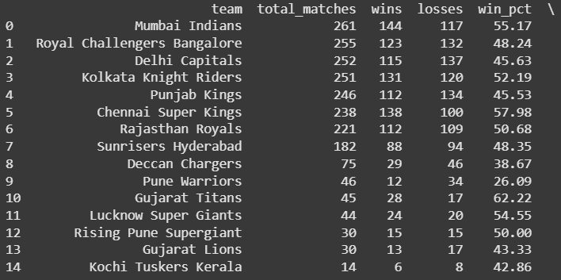
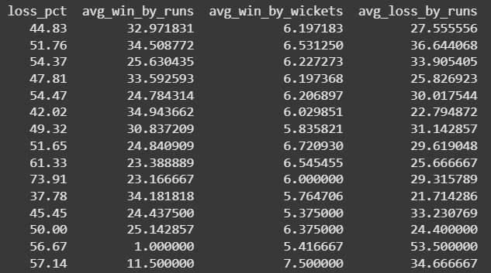
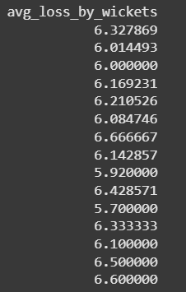
Now let us find a comprehensive team performance analysis — not just wins, but also losses and win/loss percentages.
STEP 1: Total Matches Played Per
Team
STEP 2: Total Wins Per Team
STEP 3: Merge Wins and Total
Matches to Get
Win/Loss %
STEP 4: Add Margin Stats for Wins
and Losses
STEP 5: Combine All Stats

Slide 10
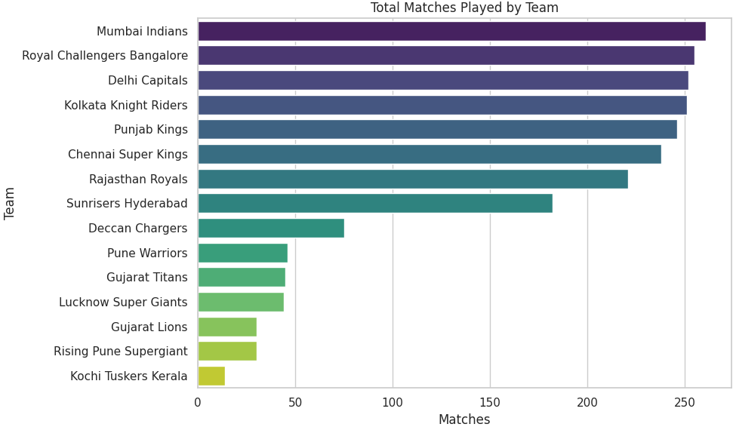
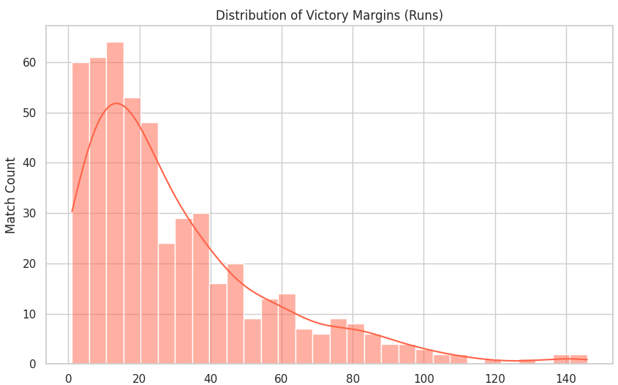
Visual Analysis:
1. Distribution of Victory Margins (Runs)
Insight: Most IPL matches won by runs have small to moderate margins.
Observation:
Majority of matches are won by less than 40 runs.
Wins by large margins (e.g., 80+ runs) are rare.
Conclusion: IPL matches tend to be closely contested, emphasizing the league’s competitive nature.
2. Total Matches Played by Each Team
Insight: Indicates team longevity and participation in the IPL.
Top Teams by Matches Played:
Mumbai Indians lead, followed closely by RCB, Delhi Capitals, and Kolkata Knight Riders.
Lower Participation: Teams like Gujarat Lions, Rising Pune Supergiant, and Kochi Tuskers Kerala played fewer matches, reflecting their shorter presence in the league.

Slide 11
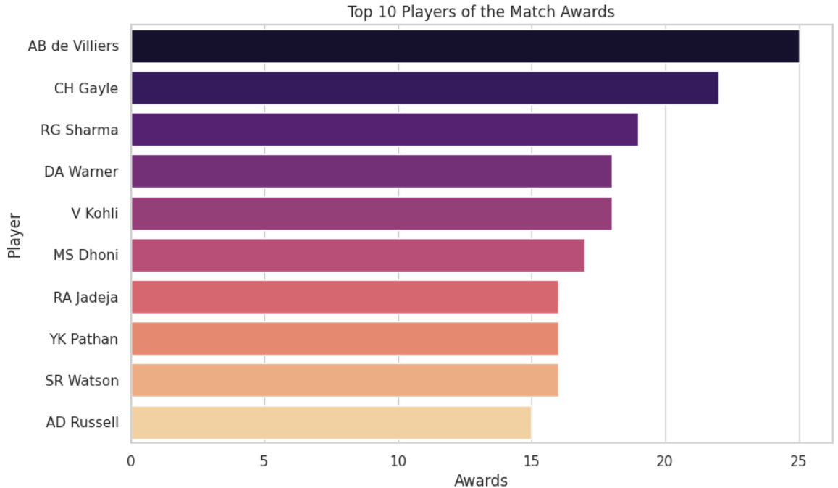
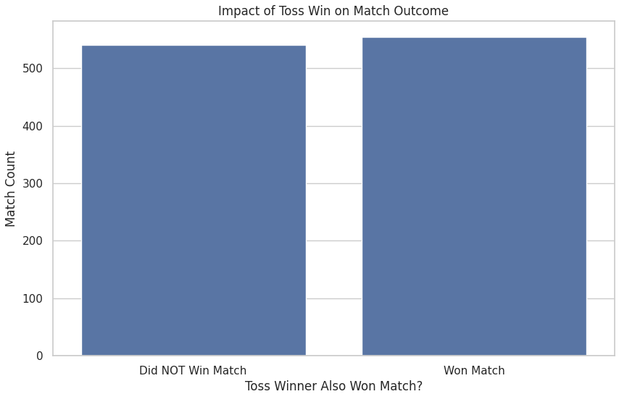
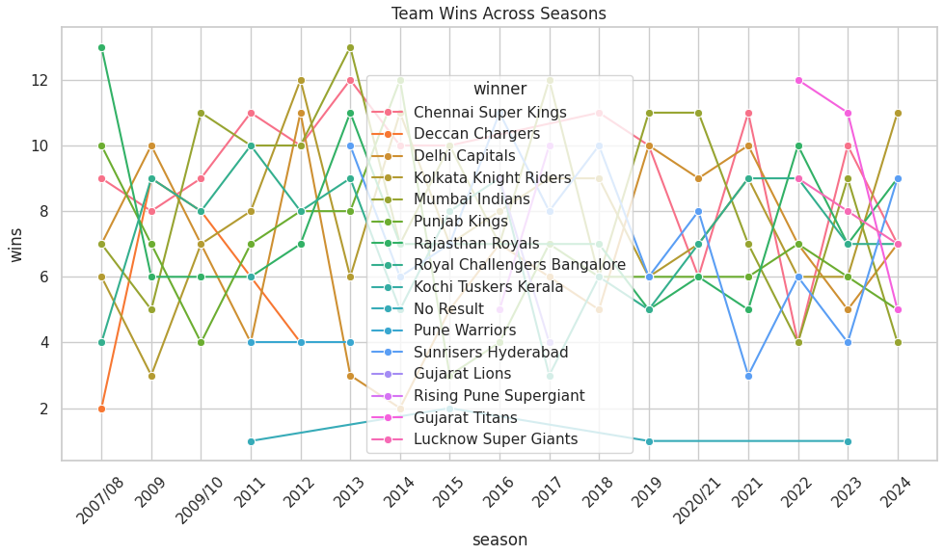
Visual Analysis:
Insight: Shows how many matches each team won per season. Mumbai Indians and Chennai Super Kings have been consistently high performers across seasons.
This chart highlights team consistency, dominance, and volatility over time, offering a clear view of which teams sustain success and which face ups and downs.
Insight: Highlights players who have had the most individual match-winning performances.
These players have had a major impact on match outcomes and are often the key game-changers for their teams.
Insight: Toss wins have limited influence on overall match results.
Winning the toss offers a minor advantage, but match performance matters more than toss results.

Slide 12
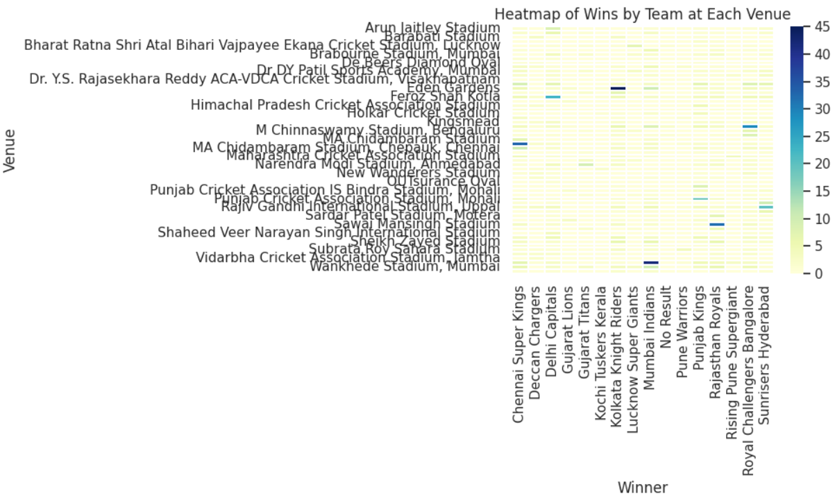
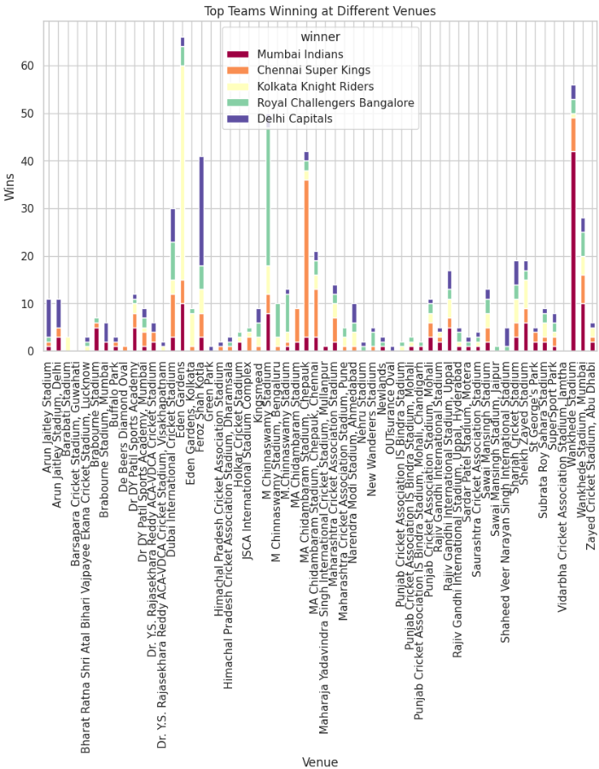
Correlation Analysis:
These charts reveal clear home ground advantages, while also highlighting venues where no team consistently dominates.
Darker areas on the heatmap show where teams have consistently performed well over the years.

Slide 13
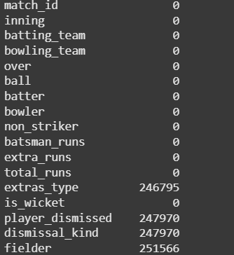
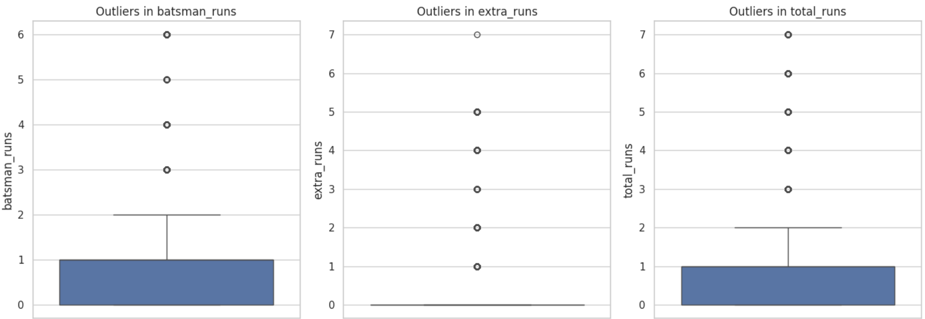
For deliveries.csv
Data Cleaning :
First step of data cleaning is to check for null and duplicate values and then handle them
Null values were found and treated by replacing the null values with suitable ones
No presence of duplicate values
Next step is to find the outliers
Since the outliers are effective for predictions in real life data they were not removed instead treated using certain methods by making the outliers into boundary values

Slide 14
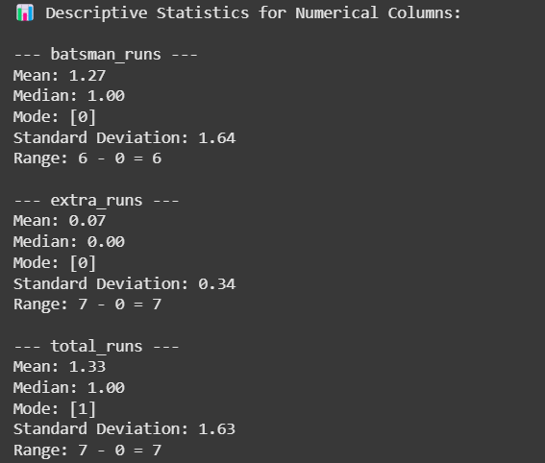
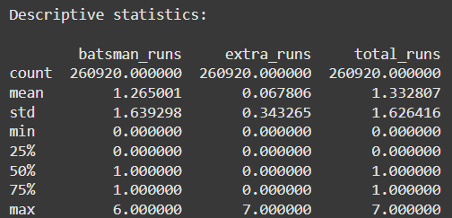
Descriptive Statistics:
- Calculate mean, median, mode etc., and summarize categorical features with value counts.
- These values are used while analyzing personal performance of each player.

Slide 15
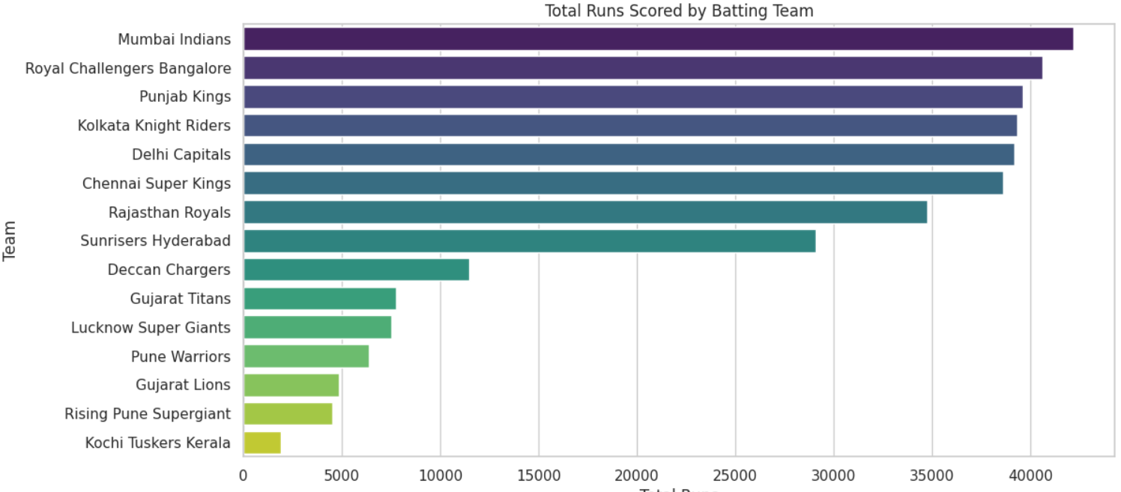
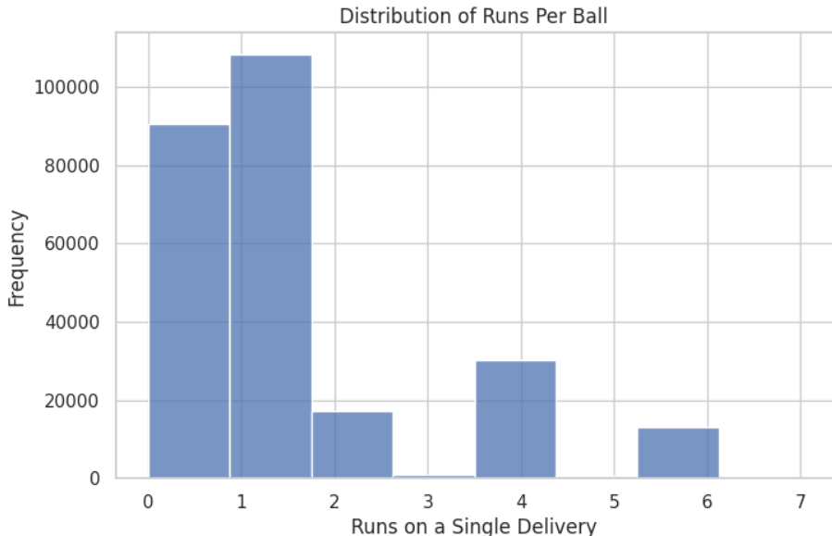
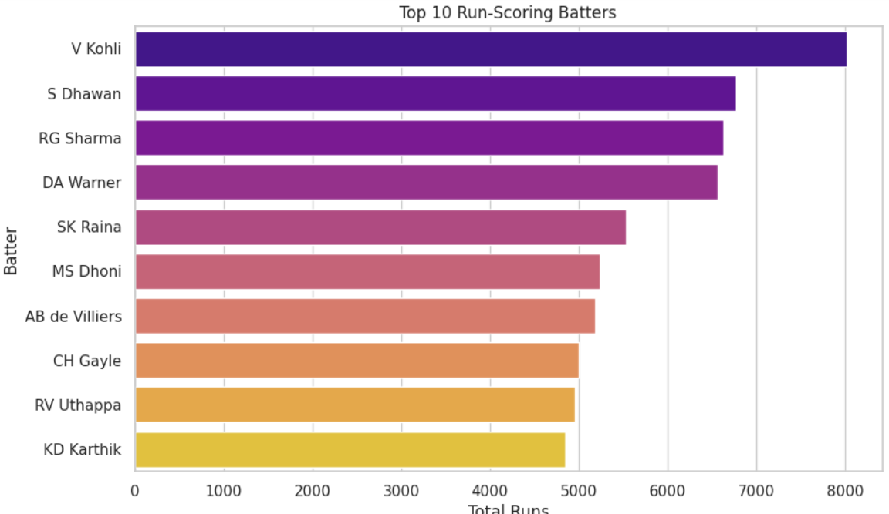
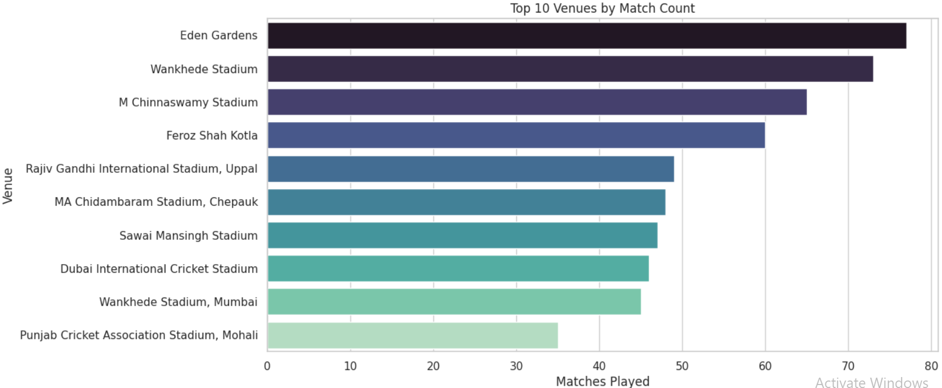
Visualizations:

Slide 16
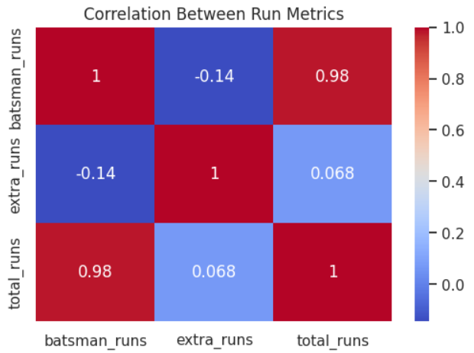
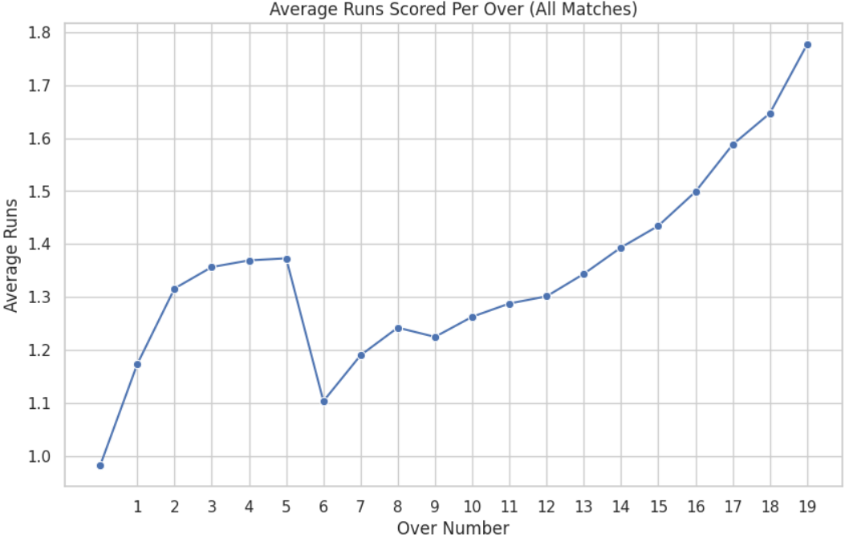
Correlations:
Perfect Multicollinearity Issue (0.98 correlation)
batsman_runs and total_runs are almost perfectly correlated
This creates a serious multicollinearity problem in your model
One of these variables should be removed to avoid redundancy
Model Performance Impact
This explains your low AUC (0.57)!
Multicollinear features confuse the model
Coefficients become unstable and unreliable
Model struggles to learn meaningful patterns

Slide 17
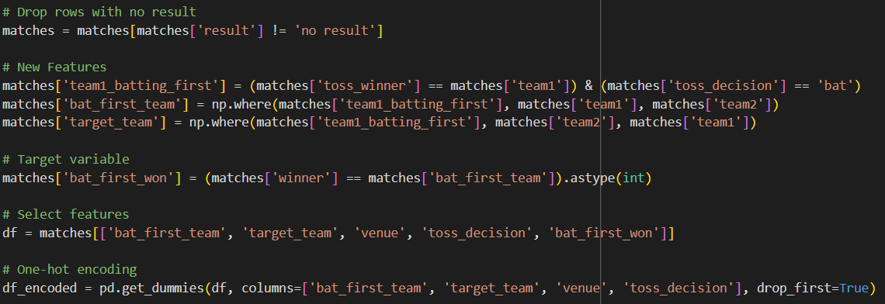
DATA MODELLING
Objective - Win Probability Model Based on Past Match and Ball-by-Ball Records and Win Probability Estimation from In-Game Metrics
Our goal is to build a predictive model that estimates the probability of a team winning a match based on key match factors such as toss outcome, venue, teams playing, and batting order. And predict the probability of the batting team winning in the second innings based on match conditions like runs scored, wickets lost, balls remaining, and required run rate.
Feature Engineering:
- We created new features like:
- bat_first_team: which team batted first
- bat_first_won: did the team batting first win?
- Encoded categorical variables using LabelEncoder
for modeling
We calculated metrics for each delivery and selected the
10th over mark (60 balls) to take a mid-match snapshot. From
this, we created a model-ready dataset with
both numerical and encoded categorical variables:
Batting & bowling teams (One-Hot Encoded)
Current score, wickets, RRR vs CRR

Slide 18
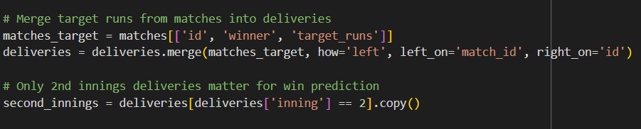
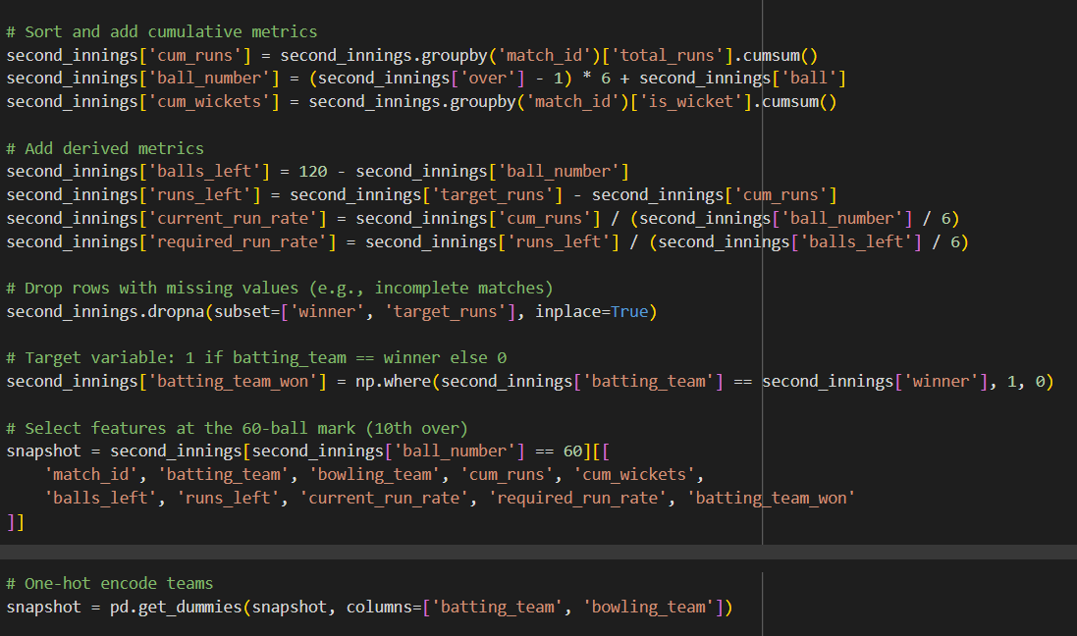
Model Selection & Training:
We selected Logistic Regression for baseline classification and Random Forest for better interpretability and non-linearity. Data was split 70/30 into training and test sets
- We visualized performance using:
Confusion Matrix, ROC Curve, Feature Importance Graph These showed that toss winner, batting order, and team strength were highly influential.
Model Interpretation:
For the Win Probability Estimation from In-Game Metrics
For this first the target run from the datasets are merged
Then cumulative metrics are sorted and added
After encoding the model is trained and validated
Then the prediction is done for the second innings

Slide 19
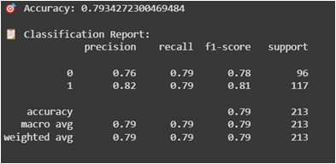
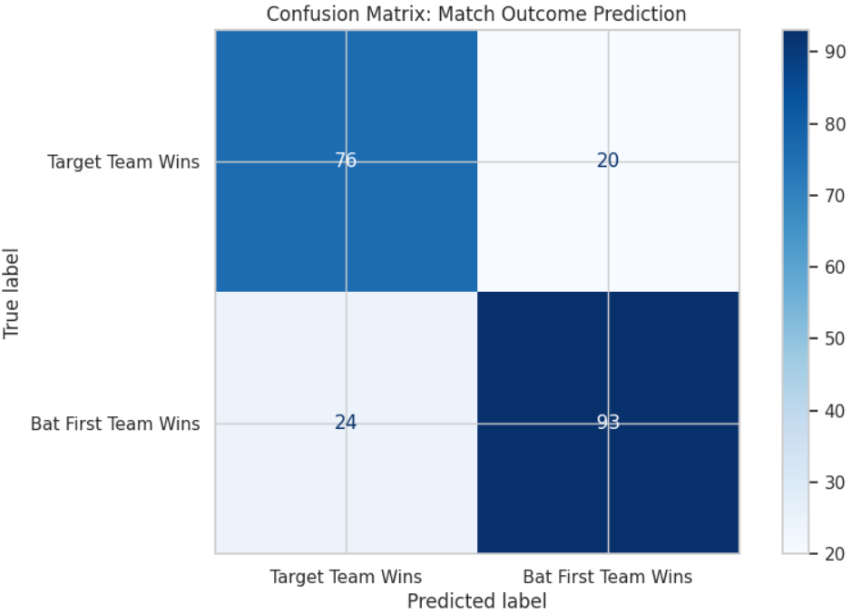
Balanced Recall:
Both classes have the same recall (0.79) → the model is equally good at identifying both outcomes (win chasing or batting first).
Better Precision for Bat-First Wins (Class 1):
Precision = 0.82 → When the model predicts a bat-first win, it's right 82% of the time.
Shows slight bias towards being more confident in bat-first win predictions.
F1-Score Consistency:
F1-scores are close and strong for both classes, indicating reliable and balanced performance.
The model performs well for both innings, with slightly better accuracy when predicting first-innings wins.
It is reasonably reliable for second innings win predictions, making it useful for real-time insights or match forecasting.

Slide 20
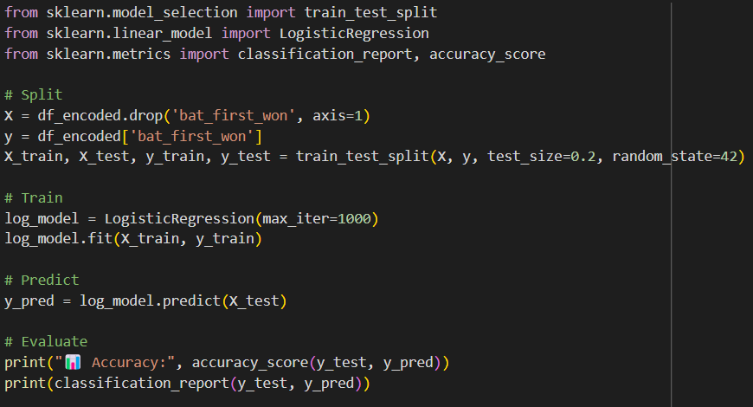
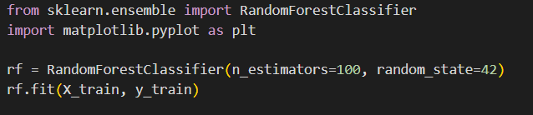
Win Probability Model Based on Past Match and Ball-by-Ball Records
First the feature engineering is done
Then the dataset is split into training and testing sets.
Now they are fitted in a Logistic Regression Model
Random Forest Classifier is also used here
Now the prediction is done by fitting the data into these models
Lastly the predictions are analyzed based on the metrics values and from the visualizations of the results
From these results we gather valuable insights

Slide 21
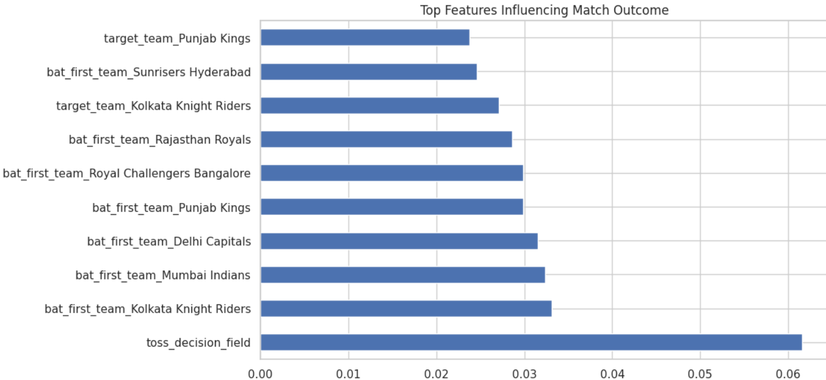
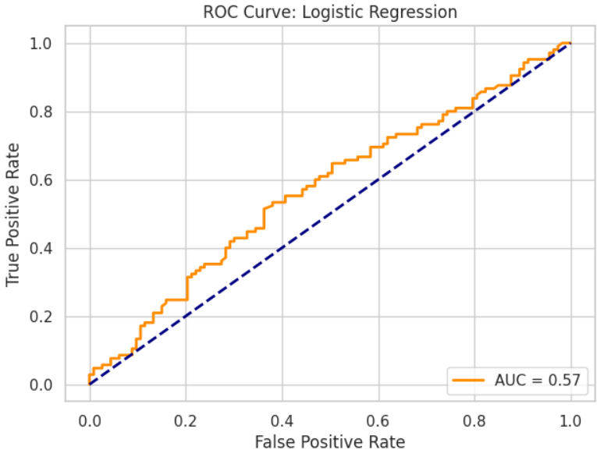
The model is not just predicting based on current runs or overs, but is learning historical patterns tied to teams and decisions.
Teams like MI or KKR might have higher chances due to better historical performance in specific scenarios.
Toss decision strategy (e.g., always fielding first when winning the toss) might be supported by such analysis.
Slightly Above Random Performance AUC of 0.57 is only marginally better than random guessing (0.50)
This suggests the current features have limited predictive power
The model is struggling to distinguish between winning and losing teams

Slide 22
CONCLUSION
We performed a complete IPL data exploration . Built a working win prediction model with good performance . Machine learning and cricket analytics can go hand-in-hand for real-time strategy
But still there is some difficulty in analyzing the IPL dataset
Why IPL Prediction is Challenging:
High Randomness in Cricket
Individual brilliance can change match outcomes
Weather, pitch conditions, toss impact
Injuries and team changes
Competitive Balance
IPL is designed for competitive balance
Salary caps and player auctions level the field
Any team can beat any other on a given day

Slide 23
THANK YOU

